Slide 1

Phonics
The importance of phonics
Pronunciation of sounds
Look at Y1 phonics screening check

Slide 2
Why we teach phonics
http://www.ruthmiskin.com/en/resources/parent-information-understanding-phonics/

Slide 3
Phoneme- the smallest unit of a sound in a word
Grapheme-letter or letters that represent a phoneme f, ph
Phonemes are represented by letters (graphemes) A child needs to learn the letters that make up each sound. This is known as phoneme-grapheme representation.
A phoneme can be represented by one or more letters i.e. ch ai n

Slide 4
Digraph-two letters which make one sound
A consonant digraph contains two consonants sh, ck, th, ll
A vowel digraph contains at least one vowel ai, ee, ar, oy
Trigraphs-three letters which make one sound igh, dge,

Slide 5
The same phoneme can be represented in more than one way
i.e. rain, may, lake
The same spelling may represent more than one phoneme
i.e. mean, deaf
This is where children need to learn to use the skill of making sense of the text.

Slide 6
Set 1, Set 2 and Set 3 sounds
http://www.ruthmiskin.com/en/resources/sound-pronunciation-guide/

Slide 7
What is segmenting and blending ?
http://www.ruthmiskin.com/en/resources/parent-tutorial-independent-blending/

Slide 8
Phonics test at the end of Year 1
The phonics screening check will be taken
individually in June by all children in Year 1.
It is designed to give teachers and parents
information on how your child is progressing in
phonics. It will help to identify whether your child
needs additional support at this stage so that they
do not fall behind in this vital early reading skill.

Slide 9
Pseudo words
These are words that are phonically decodable but are not actual words with an associated meaning e.g. brip, snorb.
Pseudo words are included in the check specifically to assess whether your child can decode a word using phonics skills and not their memory.
The pseudo words will be shown to your child with a picture of a monster and they will be asked to tell their teacher what sort of monster it is by reading the word. probably enjoy reading these words.

Slide 10
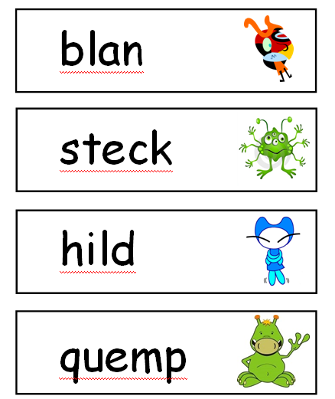
Pseudo words

Slide 11
Activities with your child
Read Write Inc sound cards
Read Write Inc books
Phonic challenges
Fred fingers

Slide 12
Websites and apps to support at home
http://www.ruthmiskin.com/en/parents/ www.oxfordowl.co.uk
Username: hemswell1 Password: classone
www.phonicsplay.co.uk
www.ictgames.com/literacy.html

Slide 13
Questions?
Any further information you think you need?
Any resources you think would help you at home?

